Slide 1
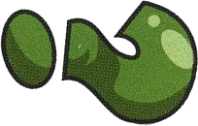



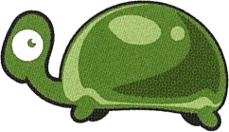
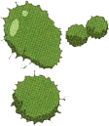

Problem summary
Dobble game
Turtle or Question mark ?
Notes:
Antoine

Slide 2
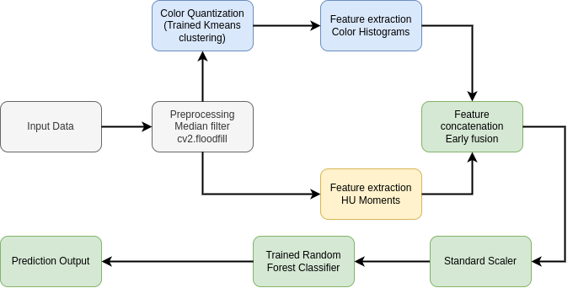
Pipeline overview
Notes:
Liliam

Slide 3
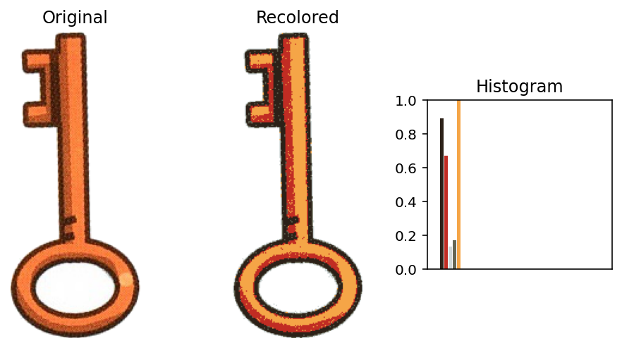
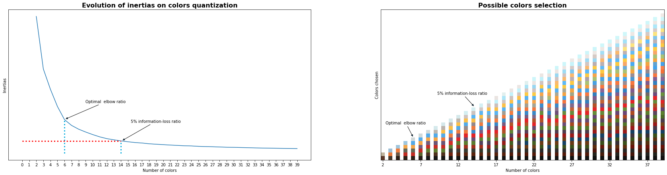
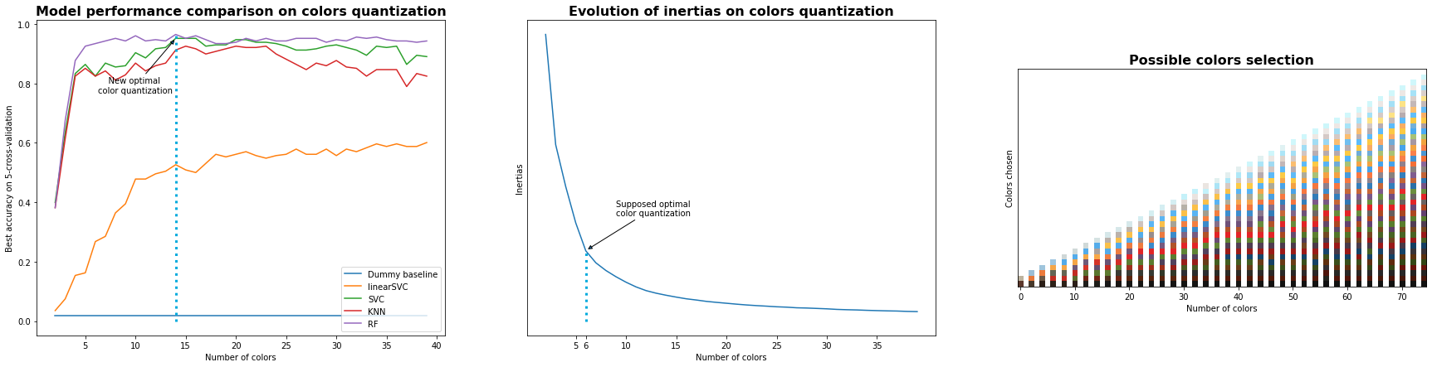
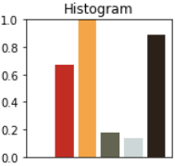

Feature extraction
Color Histogram
Notes:
Guillaume

Slide 4
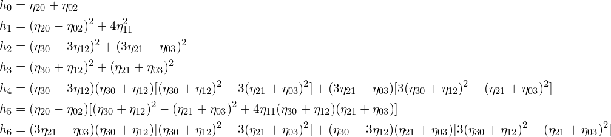
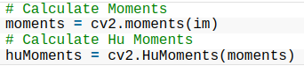
Feature extraction
Hu Moments
Rotation invariant
Scale invariant
Translation invariant
Compact
Discriminative
Using OpenCV
Notes: 7 moments maximum but the 7th is not reflection invariant
Notes:
Caillou

Slide 5
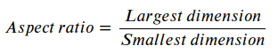
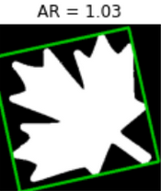
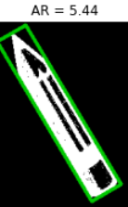
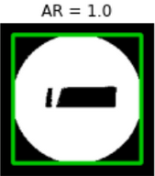
Feature extraction
Aspect ratio
Compact
Discriminative
Rotation invariant
Scale invariant
Translation invariant
Notes:
Caillou

Slide 6


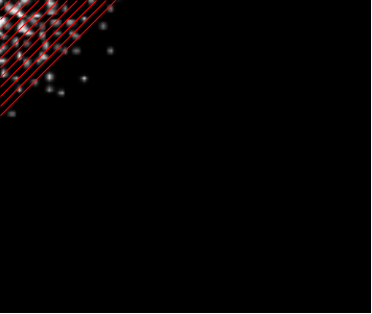


Feature extraction
DCT coefficients
Compact
Discriminative
Rotation invariant
Scale invariant
Diagonal traversal to gather coefficients
Translation invariant
Notes:
Antoine

Slide 7
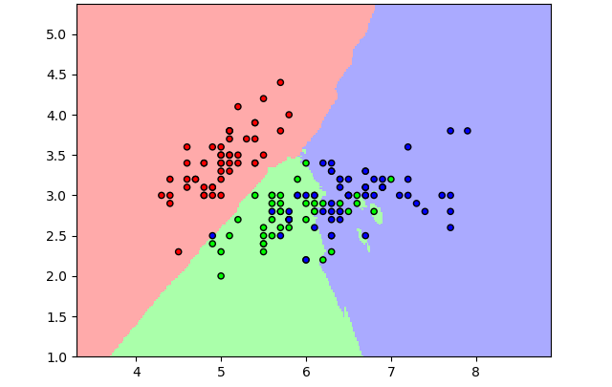
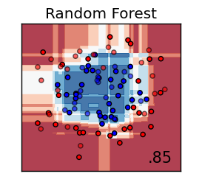
Classification
KNN
Dummy
Linear SVC
Support Vector Classifier (SVC)
K - Nearest Neighbours (KNN)
Random Forest
Notes:
Liliam

Slide 8

Classification
KNN
Dummy
Linear SVC
Support Vector Classifier (SVC)
K - Nearest Neighbours (KNN)
Random Forest

Slide 9

Experimental Setup
Split
Metrics
Train / validation split 0.8 - 0.2 for each class
Confusion matrix
Training
Validation
F1-Score
Hyperparameters tuned through cross validation on the Training set
Notes:
Guillaume

Slide 10
Result
Tableau F1-Score
Features | KNN | SVC | Linear SVC | Random Forest
Histogramme couleur | 94 % | 97 % | 60 % | 98 %
Aspect ratio | 55 % | 54 % | 7 % | 54 %
Hu Moments | 87 % | 90 % | 10 % | 99 %
DCT coefficients | 30 % | 45 % | 46 % | 49 %
Early fusion: Histogramme couleur + Hu Moments | 100 % | 98 % | 100 % | 100 %
Notes:
Caillou

Slide 11

Result
Tableau F1-Score
Features | KNN | SVC | Linear SVC | Random Forest
Histogramme couleur | 94 % | 97 % | 60 % | 98 %
Aspect ratio | 55 % | 54 % | 7 % | 54 %
Hu Moments | 87 % | 90 % | 10 % | 99 %
DCT coefficients | 30 % | 45 % | 46 % | 49 %
Early fusion: Histogramme couleur + Hu Moments | 100 % | 98 % | 100 % | 100 %

Slide 12
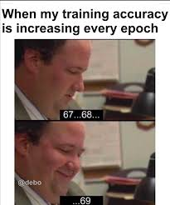
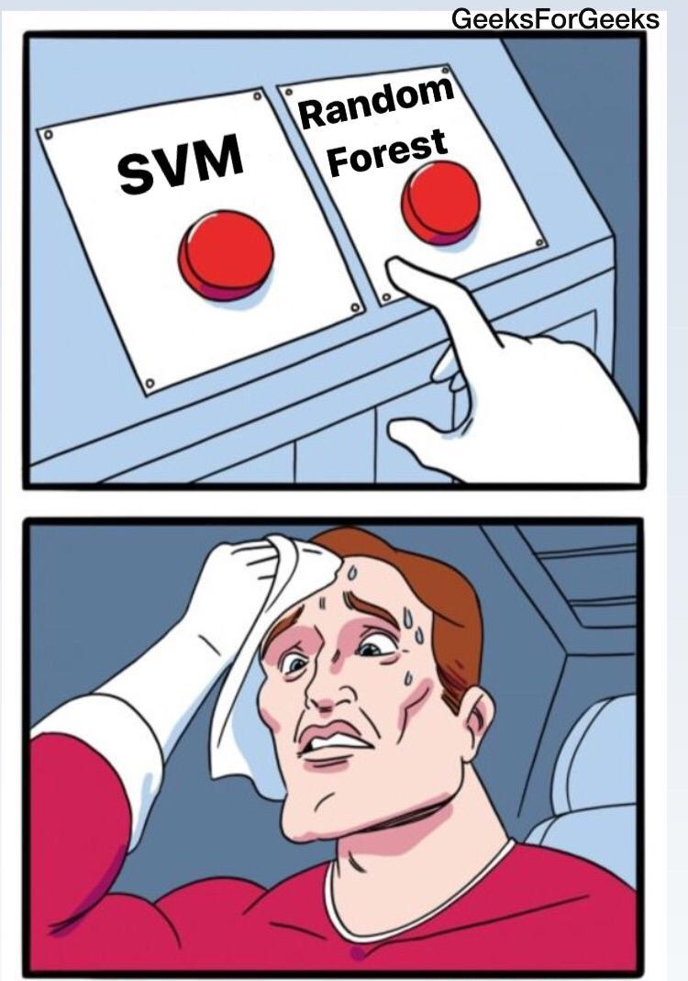


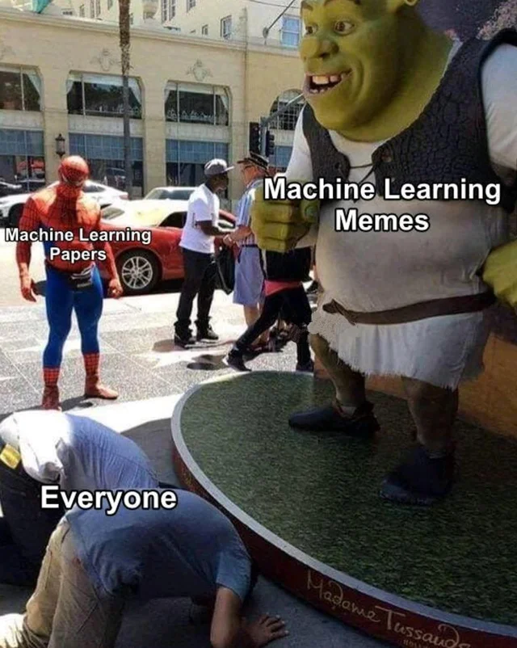

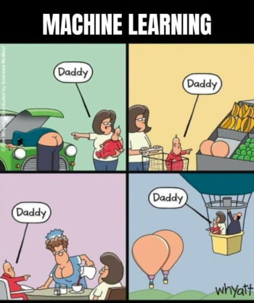
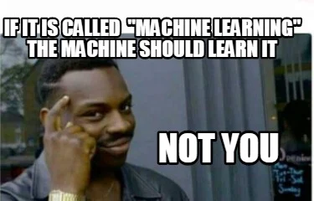
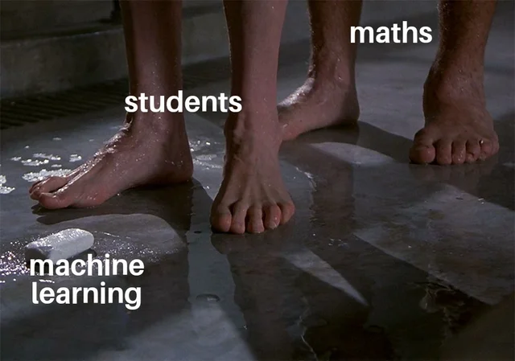
Conclusion
mété nou 20 svp

